Slide 1
Introduction to Substitution Techniques
Classical Substitution Ciphers : Letters of plaintext are replaced by other letters or by numbers or symbols
Types of Substitution Ciphers
Caesar Cipher (Shift Cipher)
Monoalphabetic Ciphers
Playfair Cipher
Hill Cipher
Affine Cipher

Slide 2
Caesar Cipher
Replaces each letter by 3rd letter
Can define transformation as:
a b c d e f g h i j k l m n o p q r s t u v w x y z = IN
D E F G H I J K L M N O P Q R S T U V W X Y Z A B C = OUT
Example:
Plaintext: meet me after the toga party
Ciphertext: PHHW PH DIWHU WKH WRJD SDUWB
Monoalphabetic Ciphers
Each plaintext letter maps to a different random ciphertext letter
Plain | a | b | c | d | e | f | g | h | i | j | k | l | m | n | o | p | q | r | s | t | u | v | w | x | y | z
Cipher | D | K | V | Q | F | I | B | J | W | P | E | S | C | X | H | T | M | Y | A | U | O | L | R | G | Z | N
Plaintext: ifwewishtoreplaceletters
Ciphertext: WIRFRWAJUHYFTSDVFSFUUFYA

Slide 3
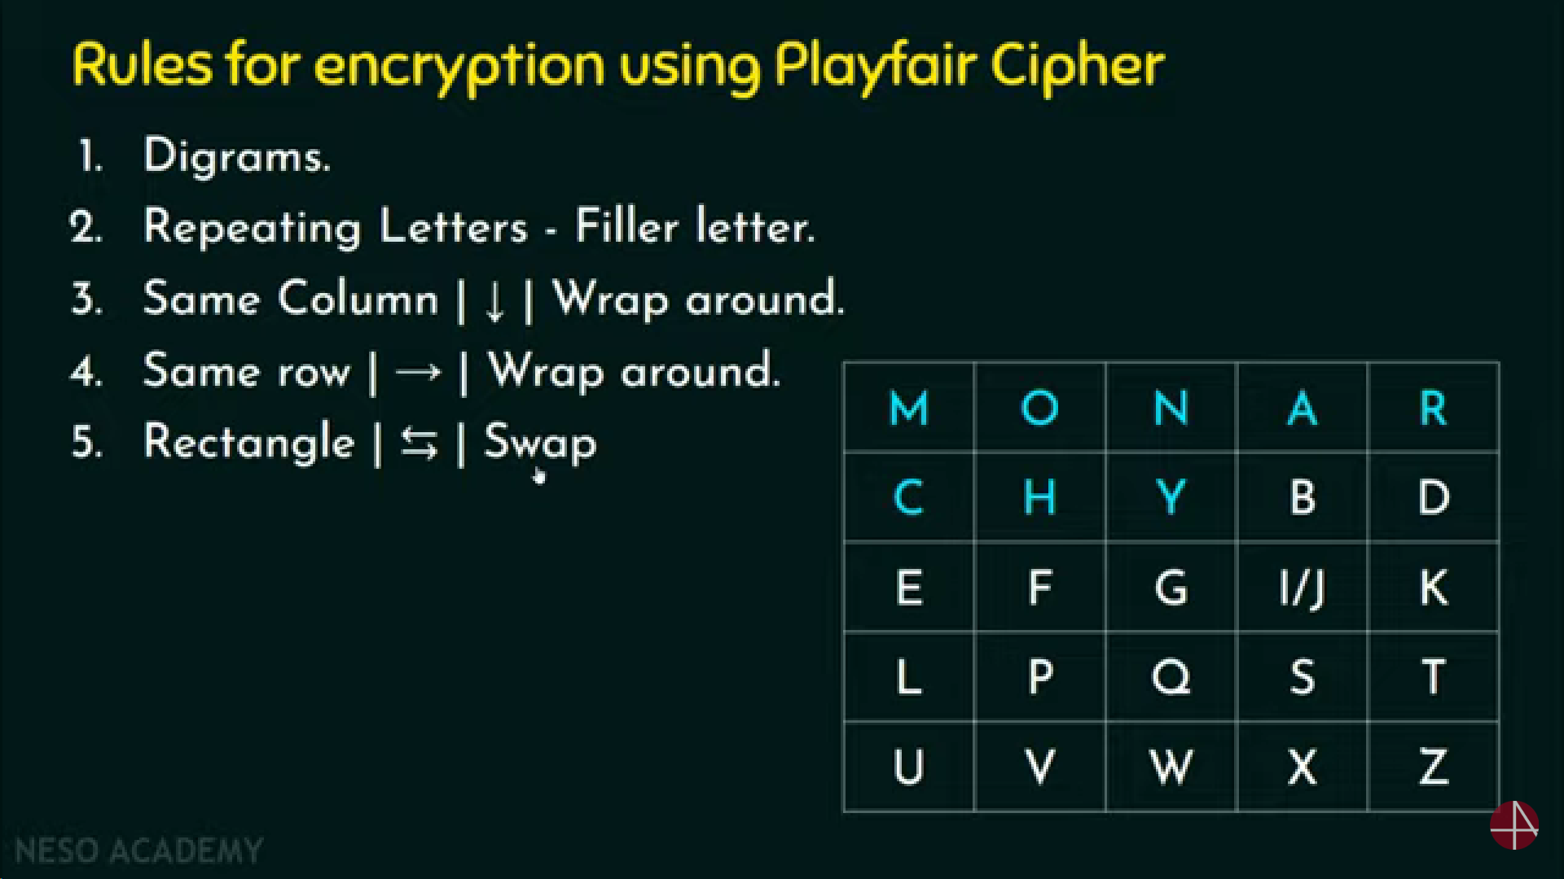
Playfair Cipher
Playfair Matrix
A 5X5 matrix of letters based on a keyword
Fill in letters of keyword (minus duplicates)
Fill rest of matrix with other letters
E.g., keyword MONARCHY

Slide 4
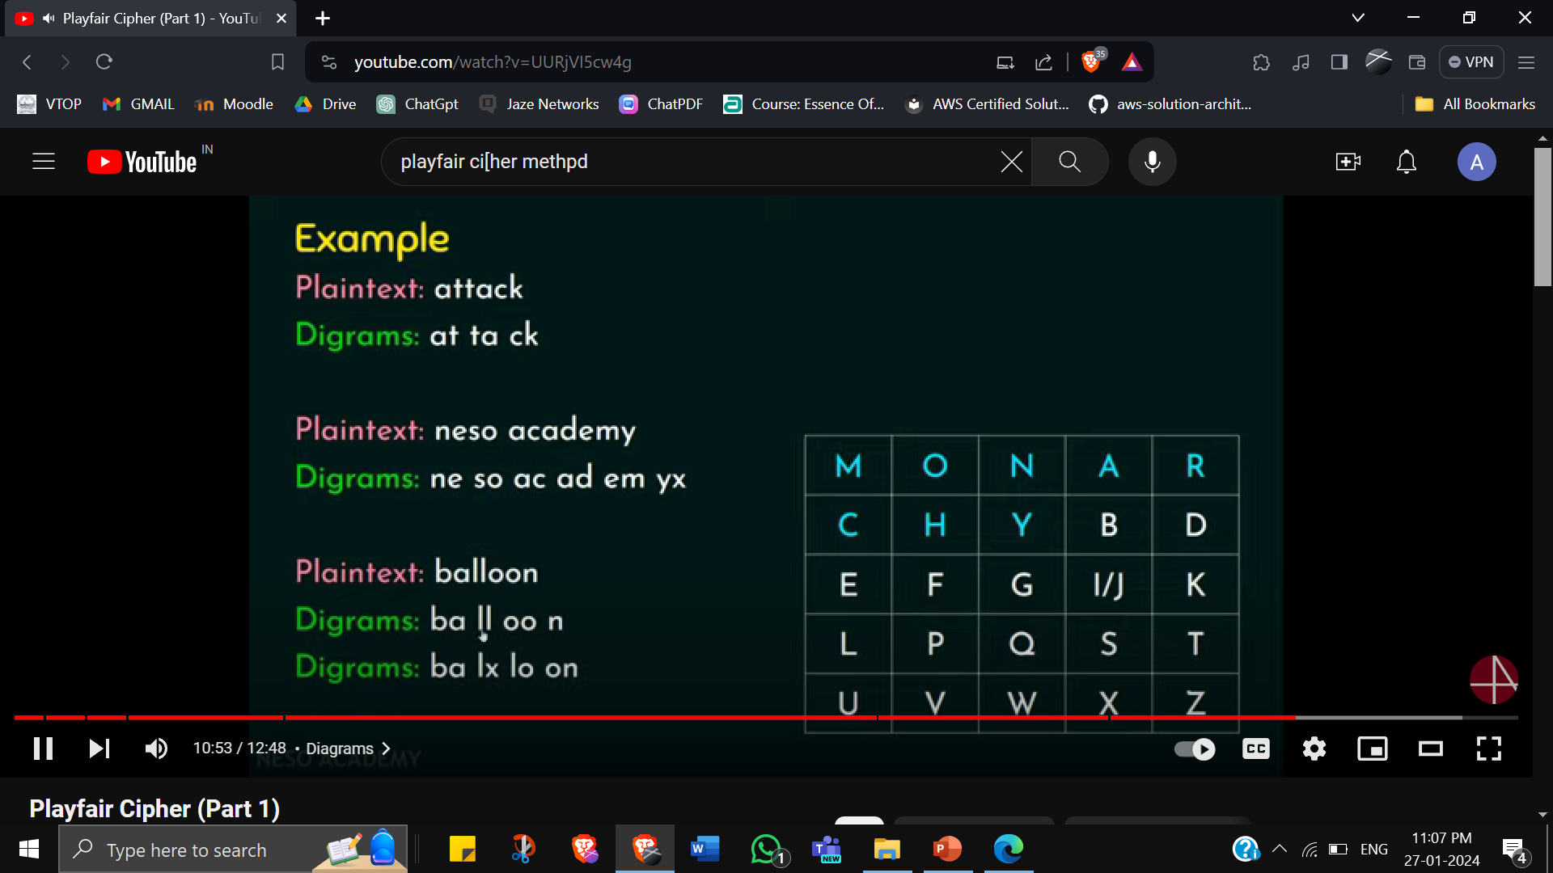
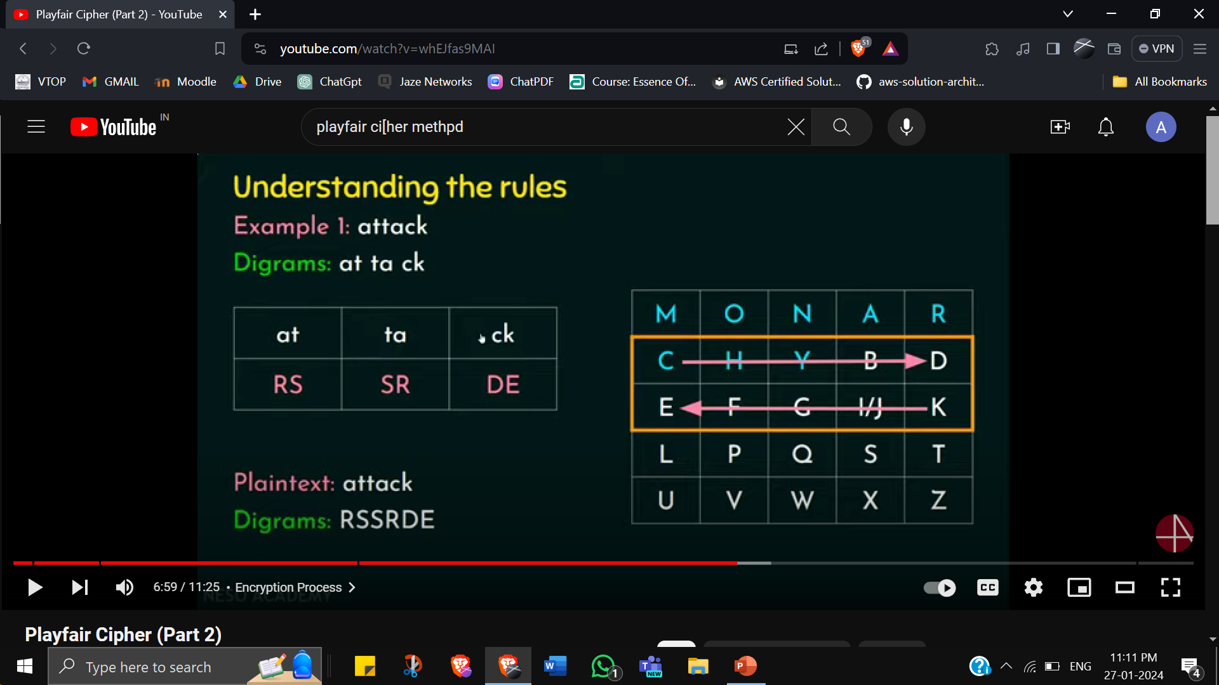
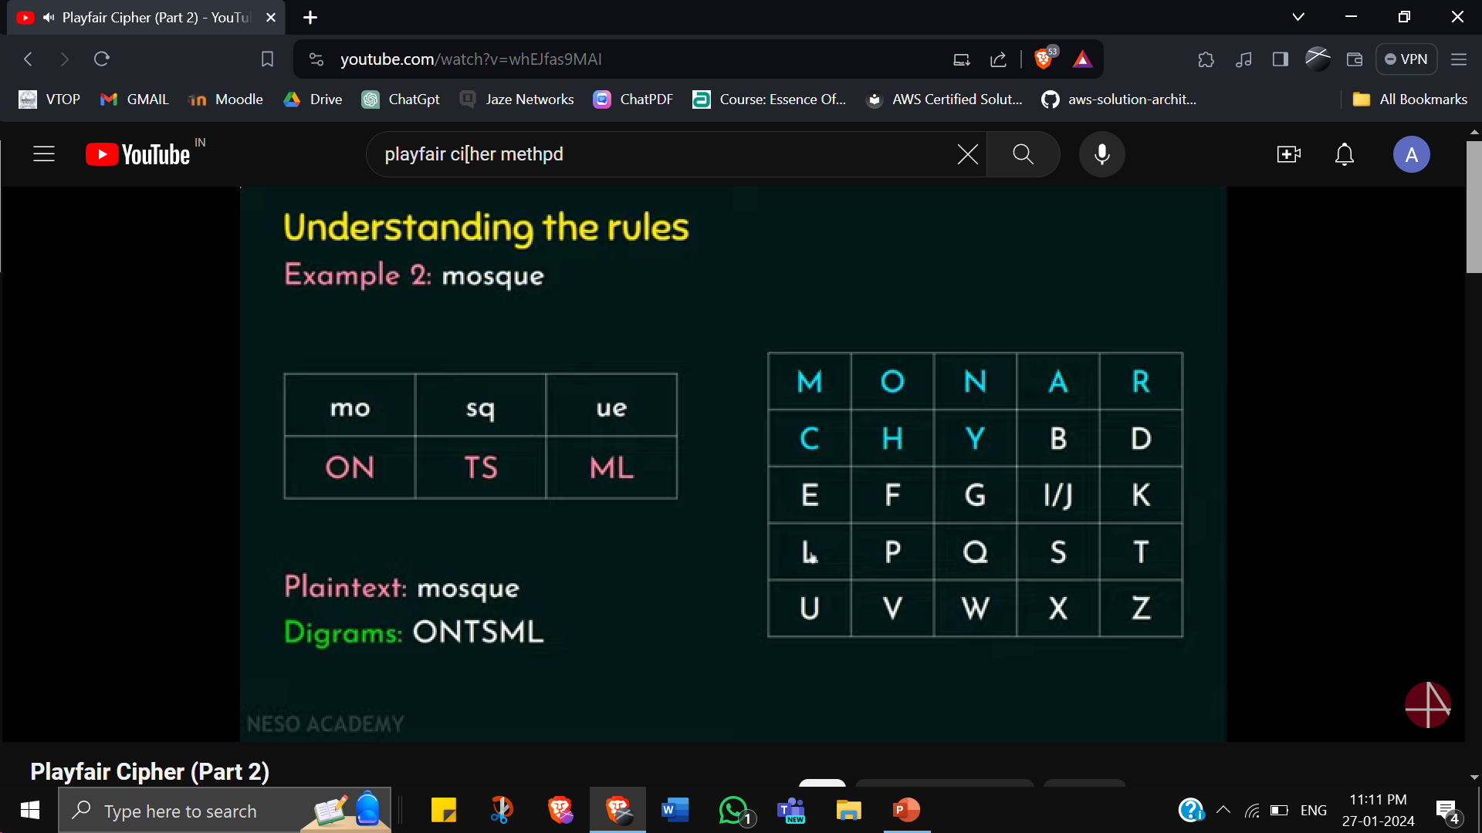
https://youtu.be/whEJfas9MAI?si=pxQUandML8es1QFO

Slide 5
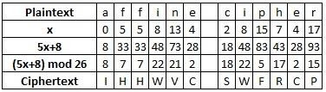
Affine Cipher Encryption
Monoalphabetic Substitution cipher
The encryption process for each letter is given by E(x) = (ax + b) mod m
Example : Encrypt the plaintext "affine cipher", using the key a = 5, b = 8
Firstly find the integer value of each of the letters in the plaintext alphabet
The calculation needed is ax + b = 5x+8
all the answers are calculated mod 26
convert the integers back to ciphertext letters

Slide 6
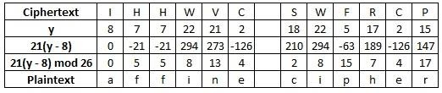
Affine Cipher Decryption
First step is to convert each of the ciphertext letters into their integer values.
Perform the following calculation on each integer D(x) = c(x - b) mod m (where c is the modular multiplicative inverse of a.) i.e., a * c = 1 mod m (perform extended Euclidean algo with a mod m)
Example: Decrypt the ciphertext "IHHWVC SWFRCP", using a key of a = 5, b = 8.
The first step here is to find c = inverse of a, which in this case is 21
We get -5 as inverse from EAA but we need +ve no. so m + c = 26 + (-5) = 21
In this case the calculation is 21(x - 8).
take these answers modulo 26
convert the integers back to plaintext letters
x
x
x

Slide 7
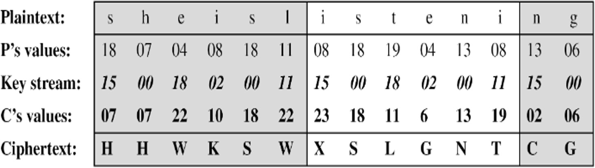
Vigenere Cipher
Polyalphabetic Substitution Cipher
Encrypt the message “She is listening” using the 6- character keyword “PASCAL = (15,0,18,2,0,11)"
Convert Plaintext into integer representation
Repeat Key as many times as needed (=length of PT)
C = (P + K) mod 26 Eg: if P = 18, K = 15, then C = (18 + 15) mod 26 = 33 mod 26 = 7 = H
Convert the integer back to its letter representation

Slide 8
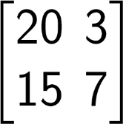
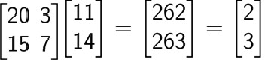
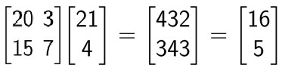
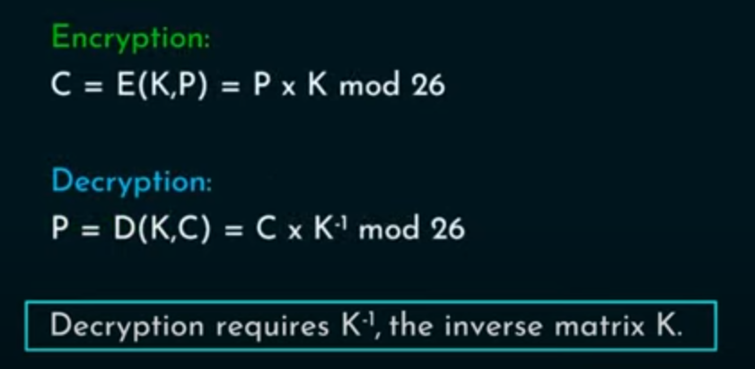


Hill Cipher Encryption
https://youtu.be/mNGj_skw7Ck?si=kTDouWvcx5rhMLMz
Encryption
Plain text: “LOVE”, Secret Key:
“LO”
“VE”
2, 3, 16, 5 are transformed to cipher text “CDQF”
→
(After performing mod 26 operation)
→
(After performing mod 26 operation)
A | B | C | D | E | F | G | H | I | J | K | L | M
0 | 1 | 2 | 3 | 4 | 5 | 6 | 7 | 8 | 9 | 10 | 11 | 12
N | O | P | Q | R | S | T | U | V | W | X | Y | Z
13 | 14 | 15 | 16 | 17 | 18 | 19 | 20 | 21 | 22 | 23 | 24 | 25

Slide 9
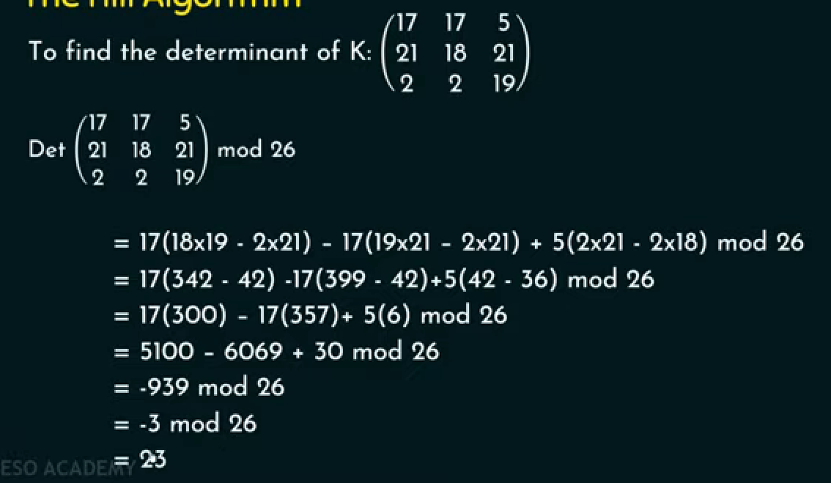
Finding inverse of matrix

Slide 10
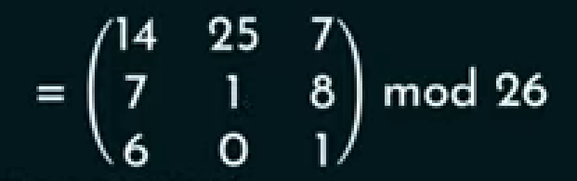
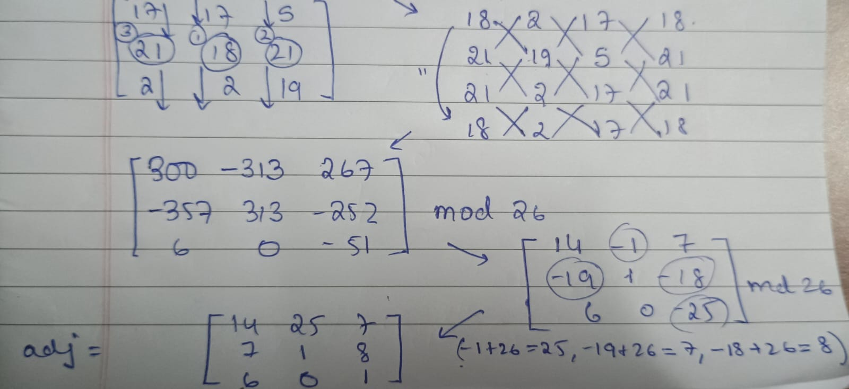
Adj k
Huge method…refer to other YT tutorials on how to find adjoint of matrix

Slide 11
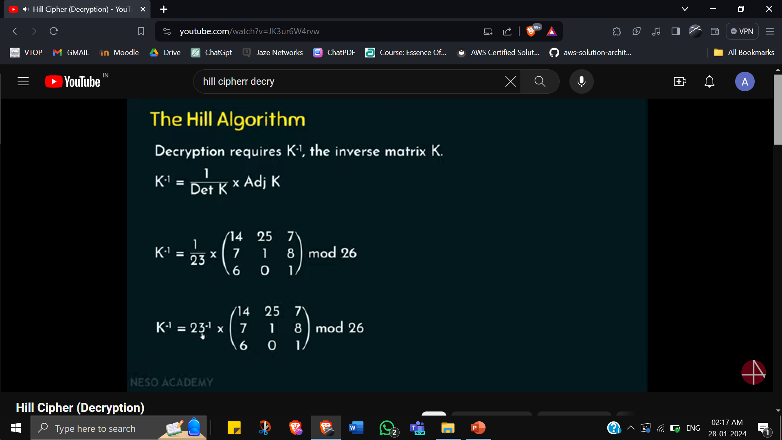
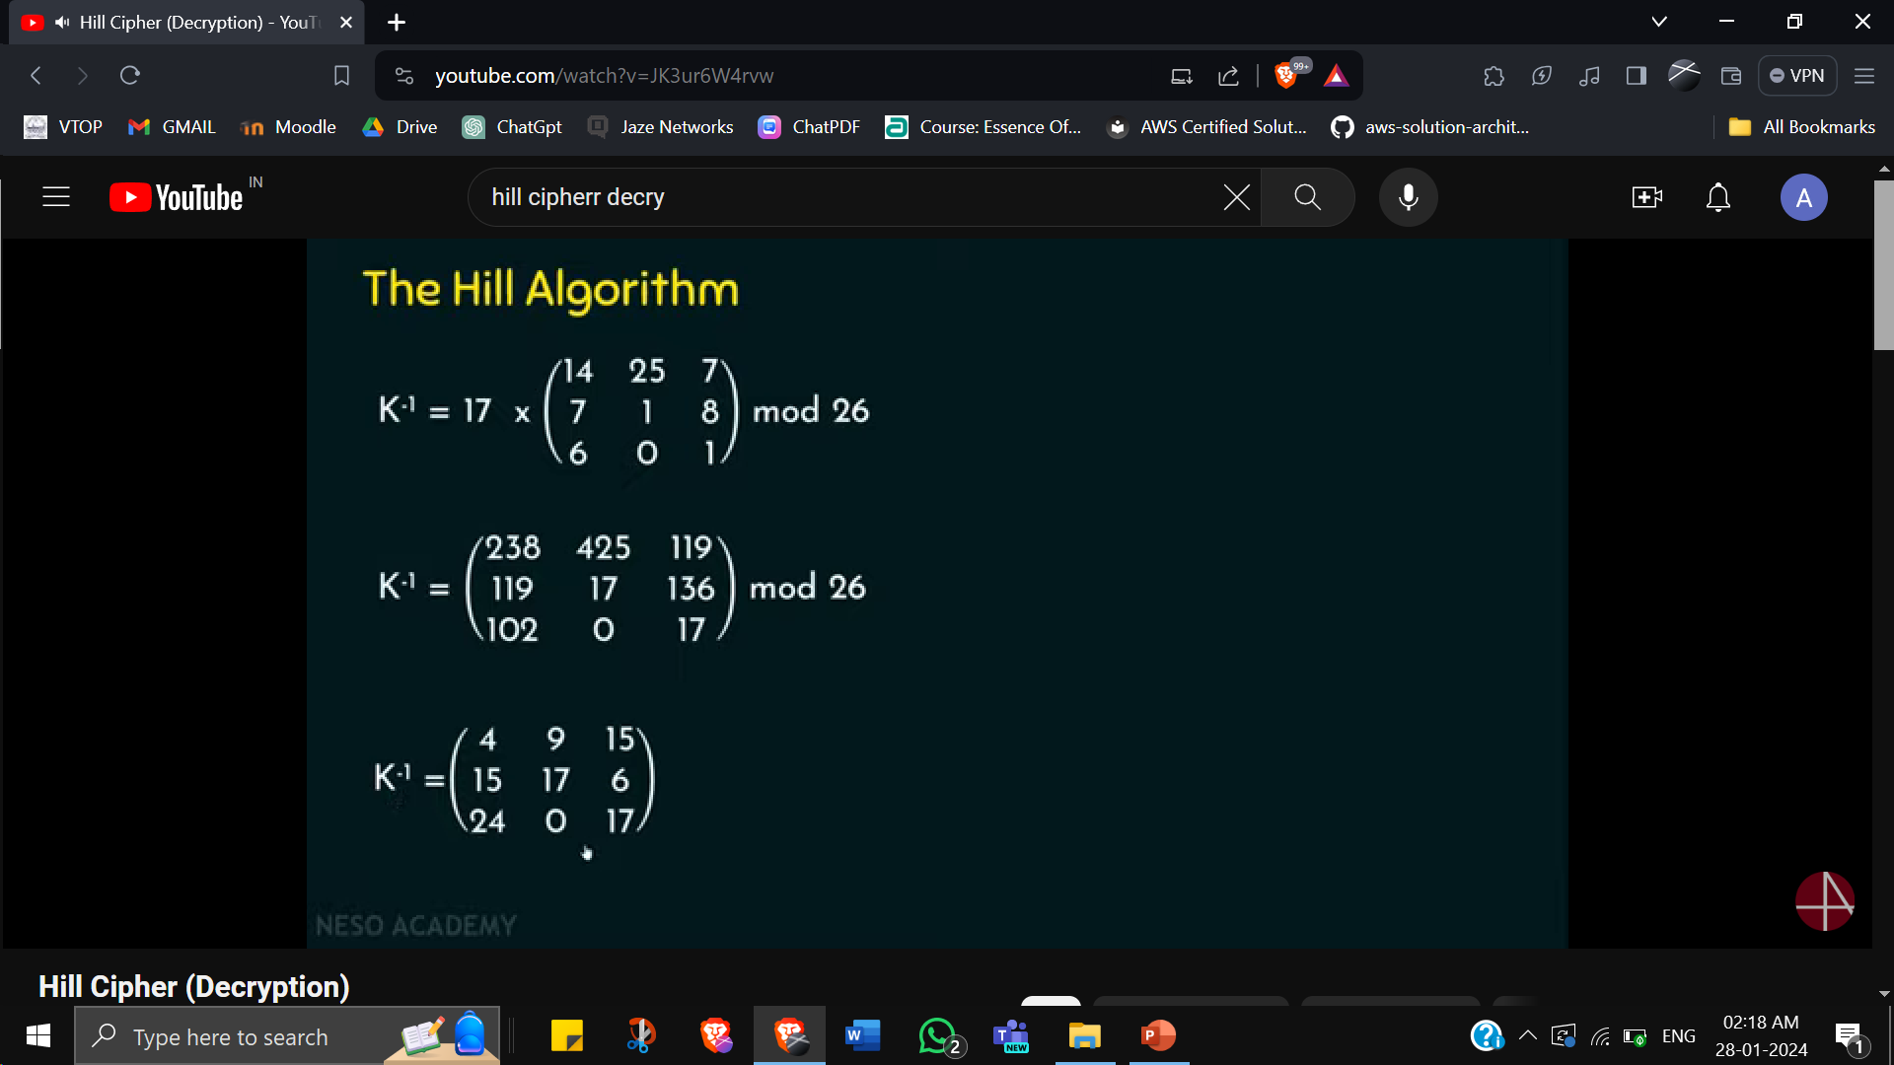

Slide 12
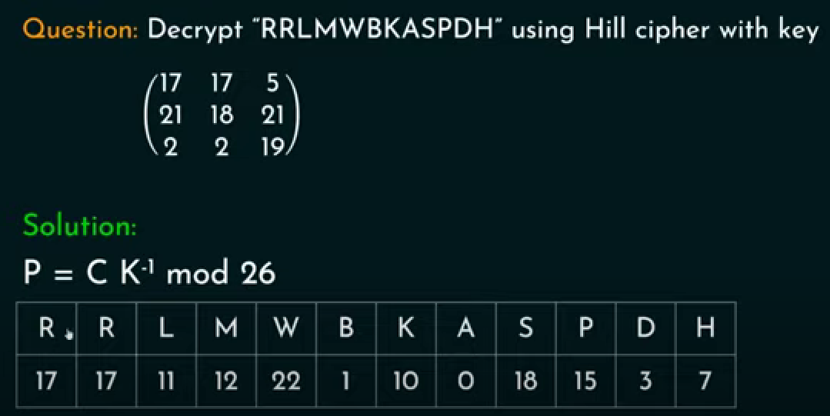
Hill Cipher Decryption

Slide 13
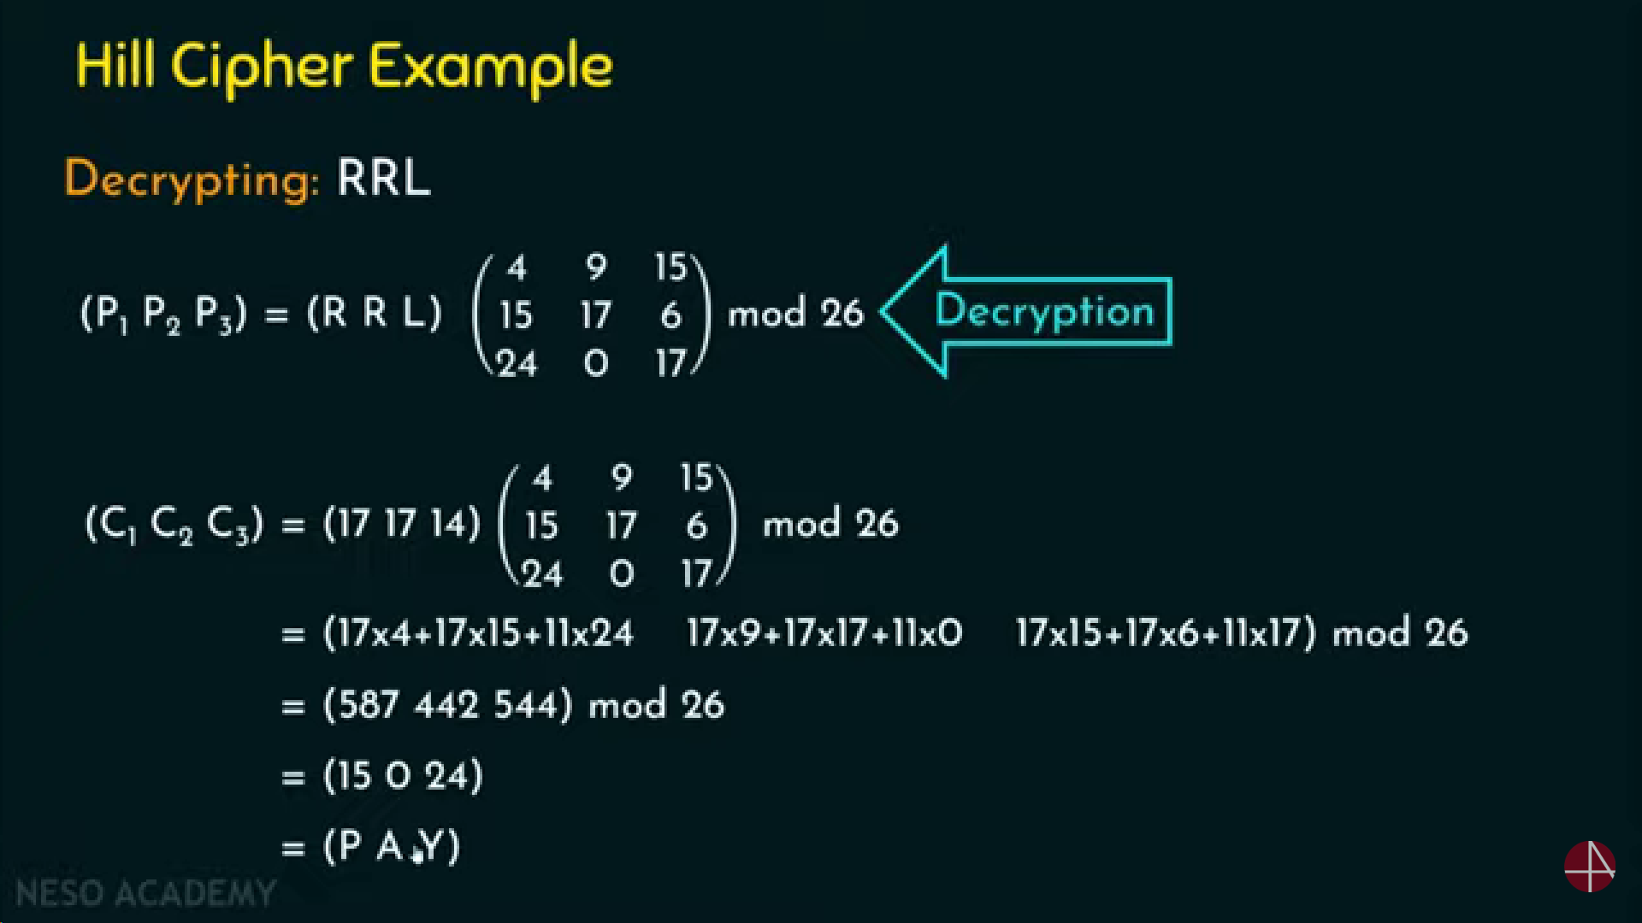

Slide 14
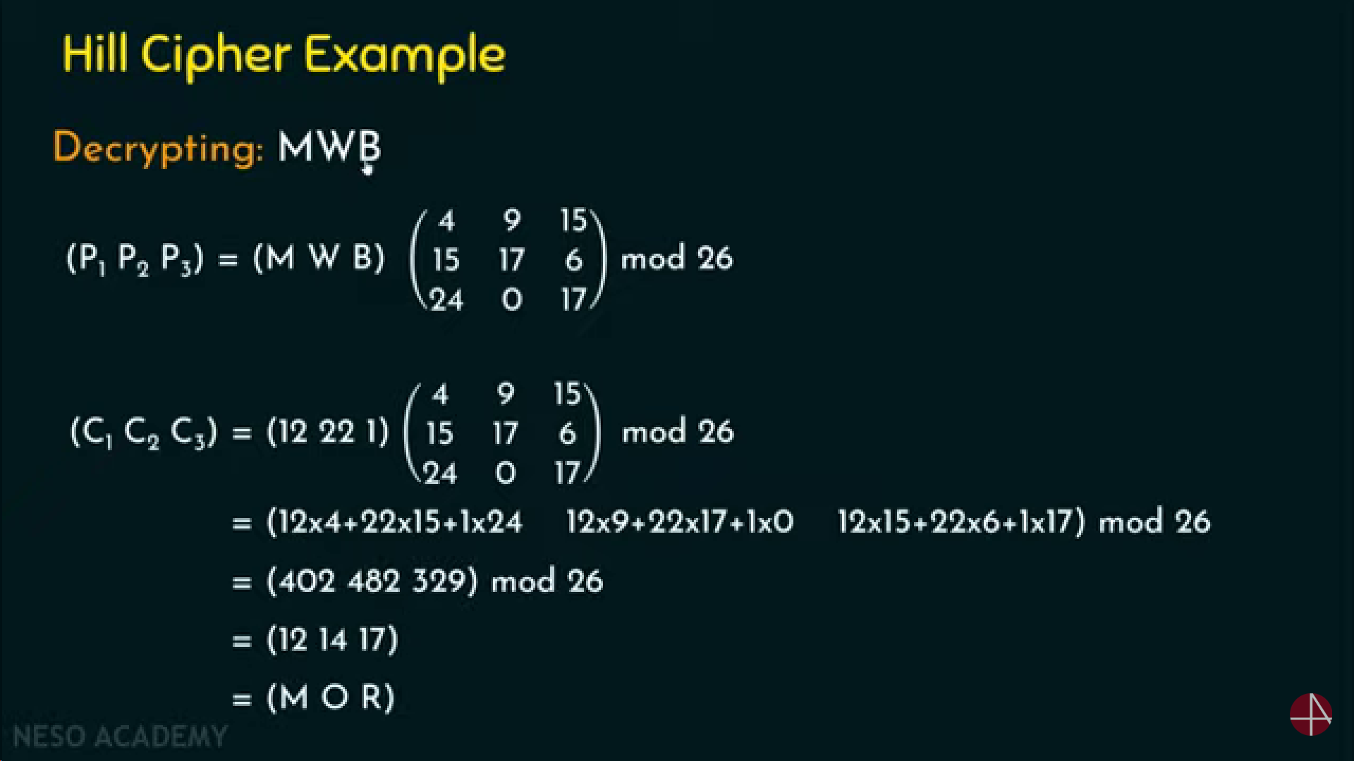

Slide 15
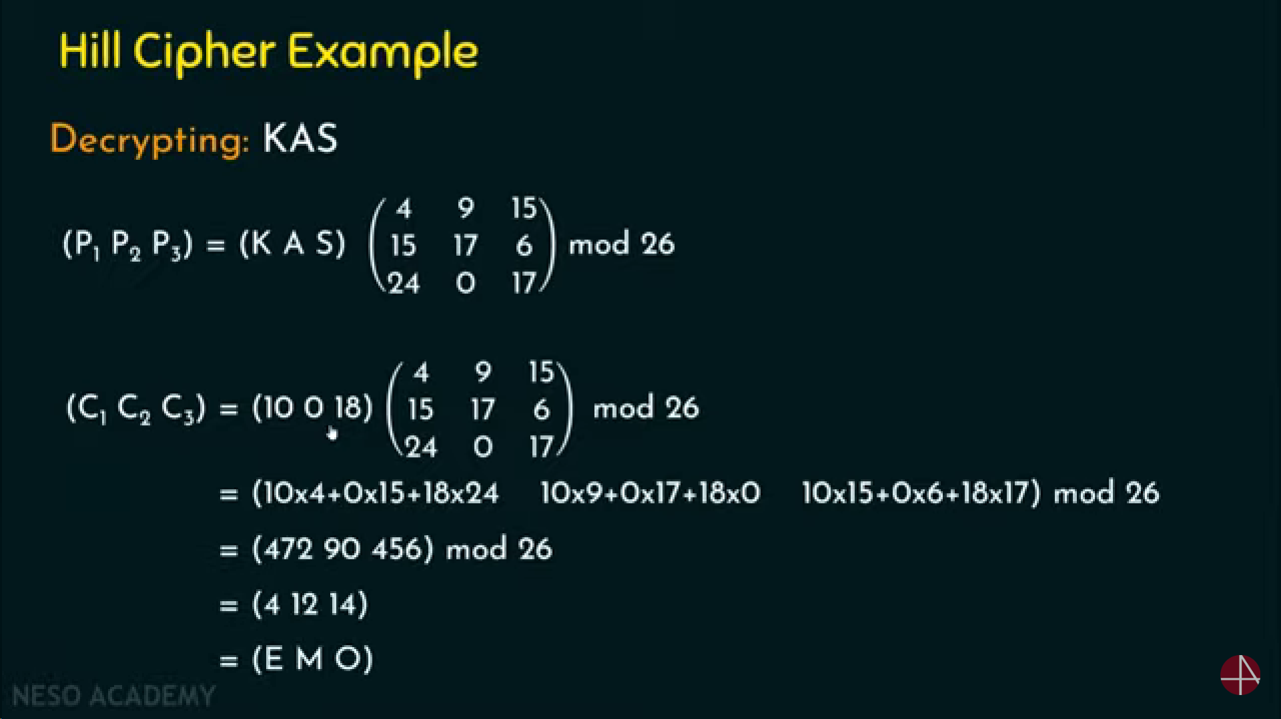

Slide 16
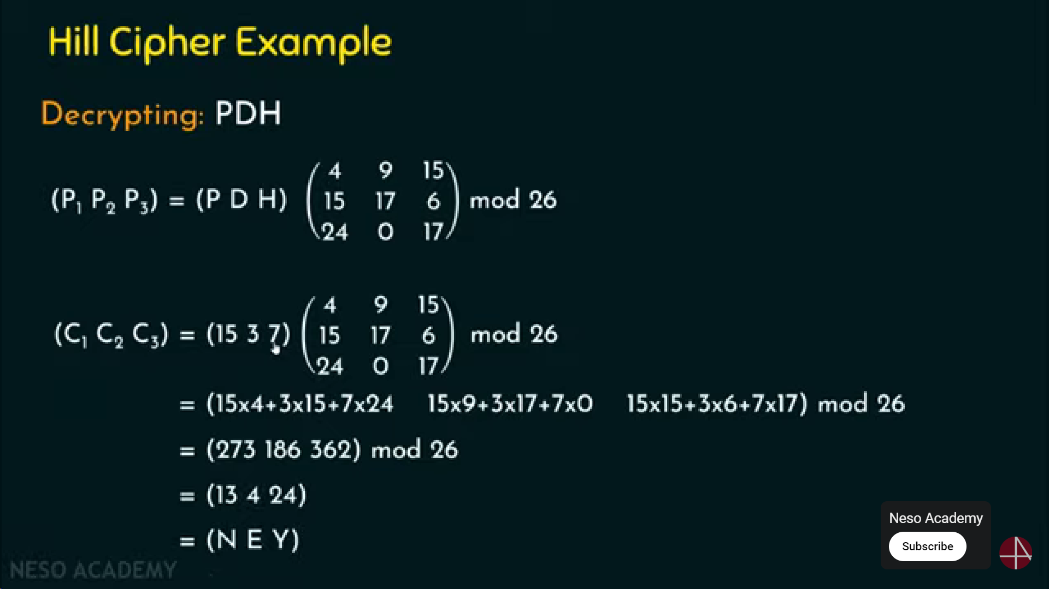

Slide 17

Rail Fence Cipher
Transposition Ciphers
These hide the message by rearranging the letter order without altering the actual letters used
Write message as a sequence of diagonals and then read off cipher row by row
Row 1 Row 2
Row 1 Row 2

Slide 18
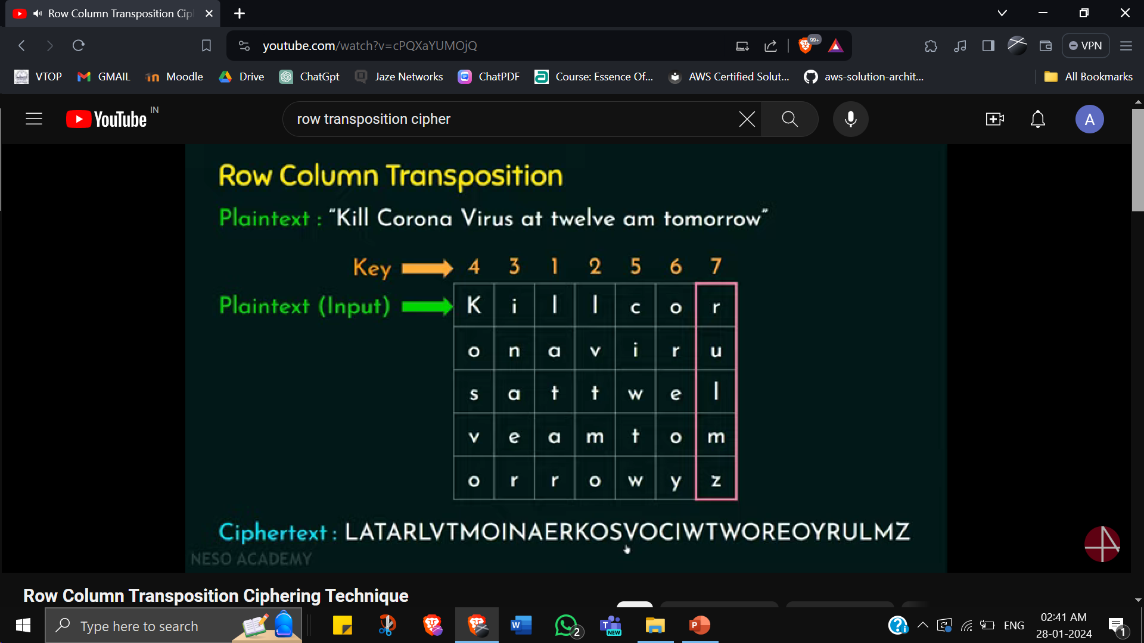
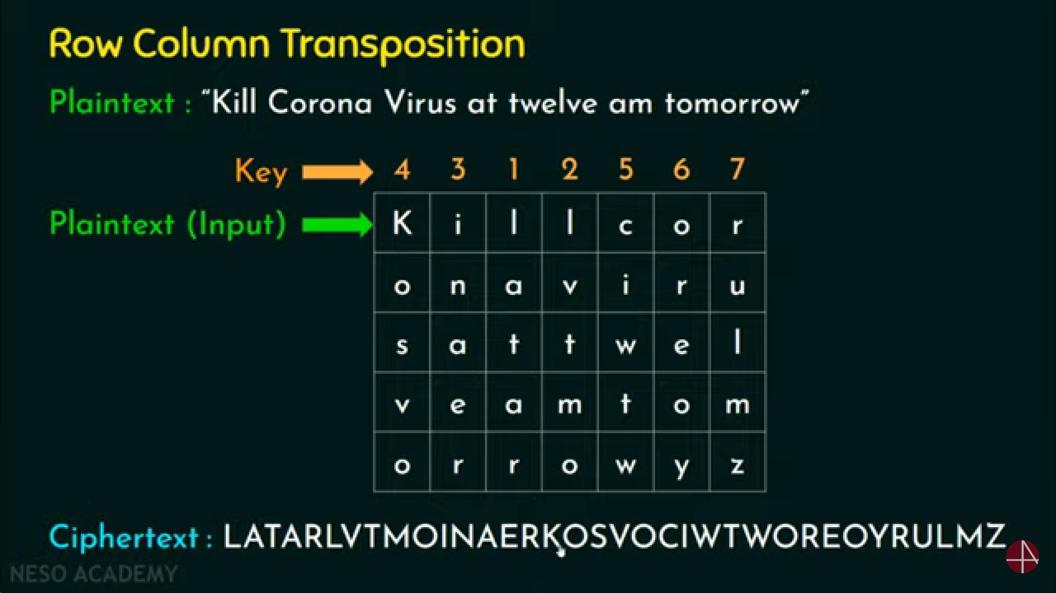

Row Transposition Cipher
Write : Row by row
Read : Column by column
Key : Order of the column
Since key here is 4 3 1 2 5 6 7, the 3rd column is read first, 4th column is read second, 2nd column is read third, and so on…
PADDING WITH y and z (random values)
1 2 3 4 5 6 7

Slide 19
Block Transposition Cipher
Arbitrary block transposition may be used
Specify permutation on block
Repeat for each block of plaintext
Key: 4931285607
Plaintext: a t t a c k p o s t p o n e d u n t i l t w o a m x y z a b
Index: 0 1 2 3 4 5 6 7 8 9 0 1 2 3 …..
Read 1st set of indices in order of mentioned key i.e 4=C, 9=T, 3=A, and so on..
Repeat with all sets
Ciphertext: CTATTSKPAO DLEONIDUPT MBAWOAXYTZ
set 1 set 2
set 1 set 2 set 3

Slide 20
Practice Problems Caesar Cipher:
Plaintext
: HELLO
Plaintext : ATTACKATONCE Ciphertext : EXXEGOEXSRGI Key - ?
Ciphertext : EBIIL Key - ?
Playfair Cipher:
Construct a playfair matrix with the key “decryption”.
Construct a playfair matrix with the key “largest”.
Using the playfair matrices constructed in (1) and (2), encrypt the following message: “I only regret that I have but one life to give for my country”
Affine Cipher:
Encrypt the plaintext “cryptography” using the key a = 2 and b = 7.
Encrypt the plaintext “continuous assessment test” using the key a = 6 and b = 9.
Decrypt the cipher text obtained in (1) and (2) using Affine Cipher.

Slide 21
Vigenere Cipher:
Encrypt the plaintext, “We are discovered save yourself” using the keyword, deceptive using Vigenere Cipher.
Encrypt the plaintext, “To be or not to be that is the question” using the keyword, relations using Vigenere Tableau.
Decrypt the ciphertexts obtained in (1) and (2) using Vigenere Cipher
Hill Cipher:
1) Encrypt
the plaintext “paymoremoney” by using the key
17 17 5
18 21
2 2 19
K= 21
2) Decrypt the ciphertext obtained in (1).
6 24 1
16 10
20 17 15
3) Encrypt the plaintext “act” by using the key K= 13
4) Decrypt the ciphertext obtained in (3).

